Slide 1
Task Force 2.0
Third General Meeting
Friday, November 13, 2020
Fourth General Meeting
Friday, December 11, 2020

Slide 2
Agenda
I. Welcome
Reports and Discussion
Oversight Working Group
Recommendations Working Group
Community Engagement Working Group
Juvenile Justice Subcommittee of Research Working Group
Spokane Report
Policing Team
Alternatives to Policing Team
Open discussion
Adourn

Slide 3
Oversight Working Group
Nick Allen nick.allen@columbialegal.org
Robert Chang changro@seattleu.edu
Adam Cornell acornell@co.snohomish.wa.us
Michele Fukawa fukawa@gonzaga.edu
Jason Gillmer gillmer@gonzaga.edu
Alexes Harris yharris@uw.edu
Melissa Lee leeme@seattleu.edu
Christina Miyamasu christina.miyamasu@kingcounty.gov
Lisa Daugaard lisa.daugaard@defender.org
Jaime Hawk jhawk@aclu-wa.org
Andrés Munoz andresemunoz1@gmail.com
Judge Theresa Doyle theresa.doyle@kingcounty.gov
Diane Clarkson diane.clarkson@piercecountywa.gov

Slide 4
Report and Discussion
Law enforcement
Community-based Organizations
Proposed criteria for invitations: person should
acknowledge or believe that race disproportionality exists in the criminal justice system;
be committed to exploring causes of race disproportionality;
be committed to addressing race disproportionalities that are not provably attributable (based on good data) to crime commission (see our 2011 report for our discussion of crime commission data and analysis).
Lack of budget previously led us to wait to invite participation.
We’re at a point where we’re comfortable beginning this.

Slide 5
Recommendations and Implementation Working Group
Nick Allen nick.allen@columbialegal.org
Jaime Hawk jhawk@aclu-wa.org
Christina Miyamasu christina.miyamasu@kingcounty.gov
Eric Richey erichey@co.whatcom.wa.us
Judge Theresa Doyle theresa.doyle@kingcounty.gov
Ali Hohman ali@defensenet.org
Nancy Talner talner@aclu-wa.org
Sahar Fathi sahar.fathi@atg.wa.gov
David Trieweiler trieweiler3@gmail.com
Ryan Dreveskracht ryan@galandabroadman.com
Jennifer Wellman Jennifer_Wellman@fd.org
Mohammed Hamoudi Mo_Hamoudi@fd.org

Slide 6
Report and discussion
Organize around “Actors”
Police
Prosecution
Defenders
Judges/Courts
Corrections (incl. local jails)
Legislature

Slide 7
Community Engagement Working Group
Sunitha Anjivel sunitha@amlawseattle.com
Lorraine Bannai bannai@seattleu.edu
Annie Benson abenson@defensenet.org
Judge Linda Coburn
Candice Garza candice.garza@cha.wa.gov
Christy Peters christy.peters@co.thurston.wa.us
Sandra Simpson simpsons@gonzaga.edu
Adrienne Wat adrienne.wat@gmail.com
Diane Clarkson diane.clarkson@piercecountywa.gov
Maria Siguenza maria.siguenza@cha.wa.gov
Andrés Munoz andresmunoz1@gmail.com

Slide 8
Juvenile Justice Subcommittee of the Research Working Group
Judge Theresa Doyle theresa.doyle@kingcounty.gov
Judge David Keenan david.keenan@kingcounty.gov
Mynor Lopez lopezm4@seattleu.edu
Tori Sullivan Lavoie sullivantori@seattleu.edu
Louisa Florio floriol@seattleu.edu
Jaime Hawk jhawk@aclu-wa.org
Anne Lee anne.lee@teamchild.org
Jessica Levin levineje@seattleu.edu
Hickory Gateless hickory@mockingbirdsociety.org
Gloria Ochoa-Bruck gochoabruck@outlook.com
Kendrick Washington kwashington@aclu-wa.org
Sara Zier sara.zier@teamchild.org
Pedro Trujillo dpedrotrujillo@law.gonzaga.edu
Judge Averil Rothrock averil.rothrock@kingcounty.gov
Julia Mizutani jmizutani@aclu-wa.org
Bailey Michaela Warrior Pahang bpahang@law.gonzaga.edu
James Keddis james.keddis@teamchild.org
Crystal Pardue cpardue@aclu-wa.org
Krista Elliott krista@padlawoffice.com
Dontay Proctor-Mills dproctor-mills@seattleu.edu
Rosemarie Clemente rosemarie.clemente@dcyf.wa.gov

Slide 9
Policing Team
Robert Chang changro@seattleu.edu
Kate Miller kmiller@seattleu.edu
Clay Mosher cmosher@wsu.edu
Chuck Reasons charles.reasons@cwu.edu
Adrienne Wat adrienne.wat@gmail.com
Luvimae Omana lomana@spokanecity.org
Nancy Talner talner@aclu-wa.org
Gabe Galanda gabe@galandabroadman.com

Slide 10
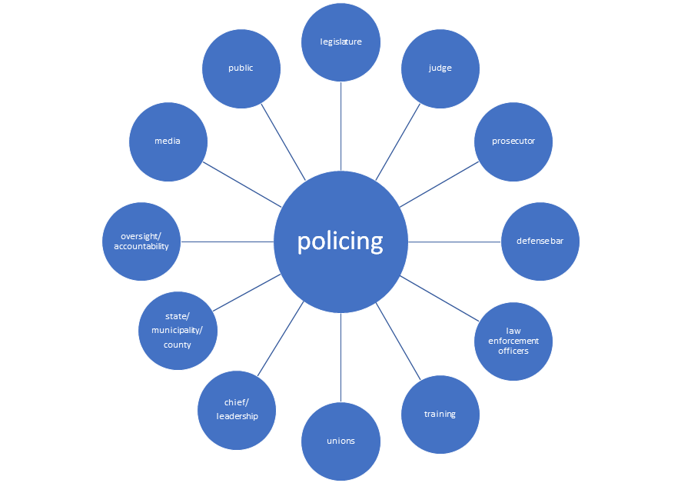
Policing is done by law enforcement officers under the direct command of the chief/leadership structure that exists within a particular law enforcement agency.
Do disproportionalities exist at:
Stops
Citations
Searches
Arrests
Use of force
Subset - deaths
What role do each of the entities in the outer circles play in fostering disproportionality or in ameliorating it

Slide 11
Alternatives to Policing Team
Lisa Daugaard lisa.daugaard@defender.org
Paul Holland hollandp@seattleu.edu
Karen Pillar karen.pillar@teamchild.org
Luvimae Omana lomana@spokanecity.org
Prachi Dave prachi.dave@defender.org
Katherine Hollingsworth khollingsworth@seattleu.edu
Sarah Max smax@seattleu.edu

Slide 12
Open Discussion

Slide 13
Closing Thoughts
We have a lot of work to do.
Following this meeting, we’ll be sending out sign-up sheets so that those who have not previously committed to a working group or team will have the opportunity to join.

Slide 14
Adjourn
Next general meeting:
Friday, Dec. 11, noon to 1:15pm,
same zoom

