Slide 1
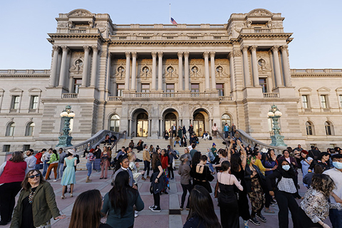
Why The Library of Congress*
(*and Other Federal Library Actors)
Still Matter
Hope O’Keeffe
Nancy E. Weiss
September 30, 2025

Slide 2
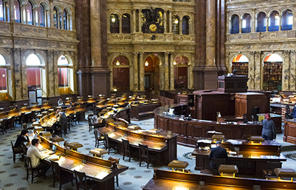
The Library of Congress At a Glance
World’s largest library, founded April 24, 1800 as the U.S. first federal cultural agency and de facto national library of the United States
Home of U.S. Copyright Office, Congressional Research Service, congress.gov, Law Library of Congress, National Library for the Blind and Print Disabled, American Folklife Center, Veterans History Project, FedLink, Center for the Book, 6 international offices
More than 178.2 million items in its collections
Not just books - serials, photos, films, sound recordings, maps, musical scores (and instruments), manuscripts, special collections
Half of items not in English; 470 languages represented
Over 10,000 items added per day, including copyright deposits
Collections are increasingly digital, whether digitized or born digital. Collections are now digital-first
Provider of critical resources to the library community

Slide 3
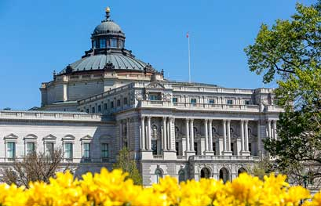
The Library of Congress Matters
Memory palace of American and world culture and knowledge
Mission: “Engage, inspire, and inform Congress and the American people with a universal and enduring source of knowledge and creativity.”
Since 1870, home of the U.S. Copyright Office and the “mint record of American creativity”
Collections are accessible on site to anyone over 16 with an id, and online to everyone worldwide
Nonpartisan research arm of Congress and key resource
CRS and congress.gov
Leader and key resource in library community
Cataloguing services for much of the world
Interlibrary loan lender of last resort
Coordinator of national network of libraries serving vision-impaired
Home of Center for the Book
Convenor and provider of grants and resources
Federal funding of LC builds and preserves legacy and new collections and pioneers new library technologies

Slide 4
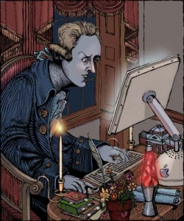
A Nonpartisan, Legislative Branch Library of Congress Matters
Protection of Library Content:
Thomas Jefferson: “There is in fact no subject to which a member of Congress [or the public] may not have occasion to refer.”
Privacy of Reader Records
Fundamental principle of librarianship: “Scimus quae legis, et non dicimus”
Protection of Sensitive Material
Materials under copyright
Closed collections
Classified material, attorney-client records, grand jury records
Nonpartisan, Confidential Congressional Research Service:
Nonpartisan advisor to members of Congress
Highly confidential research and advice in response to Member inquiries
Image “Thomas Jefferson’s Favorite Websites,”
used with permission, courtesy of Robert Meganck

Slide 5
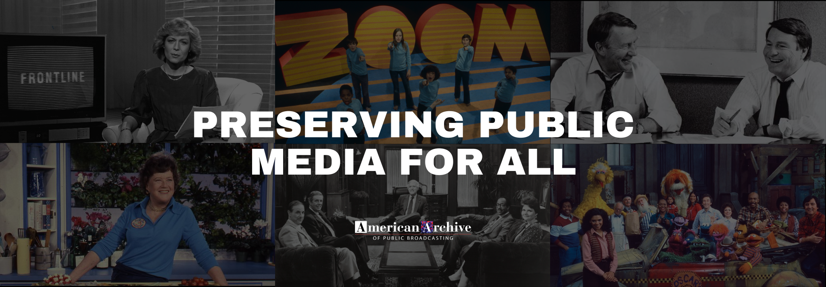
Preserving Public Broadcasting Matters:
American Archive for Public Broadcasting

Slide 6
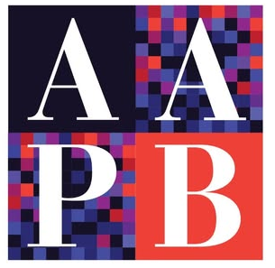
American Archive of Public Broadcasting
Mission: “to preserve and make accessible significant historical content created by public media, and to coordinate a national effort to save at-risk public media before its content is lost to posterity.”
Partnership between GBH & LC, created 2013 with CPB funding
Over 2.5 million metadata records
Currently over 215 stations participating
Focus on outreach to stations most at risk
Over 252,600 programs digitized and preserved.
152,250 online
Joint management
GBH manages the project, including subgrants, website, and fundraising
LC holds and preserves the collection (along with other public media collections)
LC and GBH collaborate on management and legal issues
“It is so important, now more than ever, to preserve this material. Not only are the tapes disintegrating, but who knows which stations may not exist in the future. The local community stories, the stations created and covered, will be lost if not preserved now.”
- Karen Cariani, Project Director

Slide 7
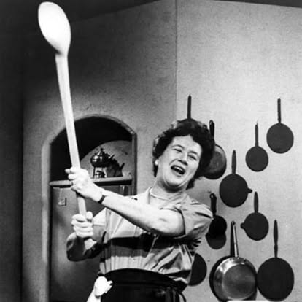
AAPB Legal Issues: Online Reading Room
All materials are available on premises. LC and GBH attorneys determine what can go online
Primary issues: copyright and privacy.
Consider contracts, law, ethics, risk management
Layers of protection:
quitclaim release or license from contributor
Website terms of use: limited to personal, noncommercial
Evaluate content by “bucket” category to assess fair use
Eg, news, documentaries, criticism, entertainment
Is presentation of historical broadcast transformational
Examine privacy issues such as children, health care, sensitivity
Stoplight approach: Green (online), red (premises only), yellow (legal evaluation)
Notice and takedown
No takedown requests since initiation
Julia Child, courtesy GBH

Slide 8
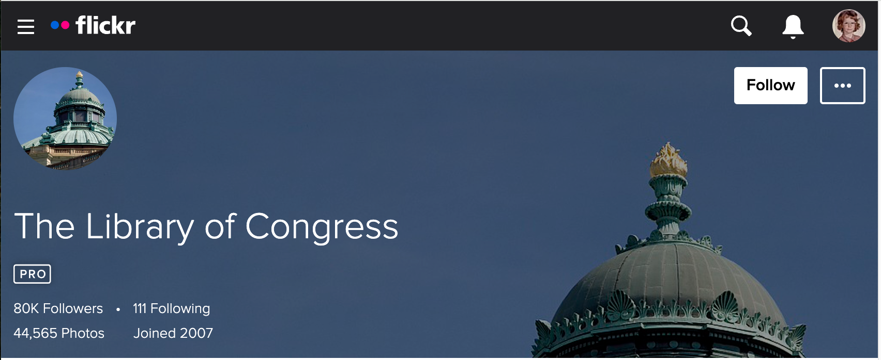
Digital Access and Preserving Social Media Matter:
Flickr Commons and Data Lifeboat

Slide 9
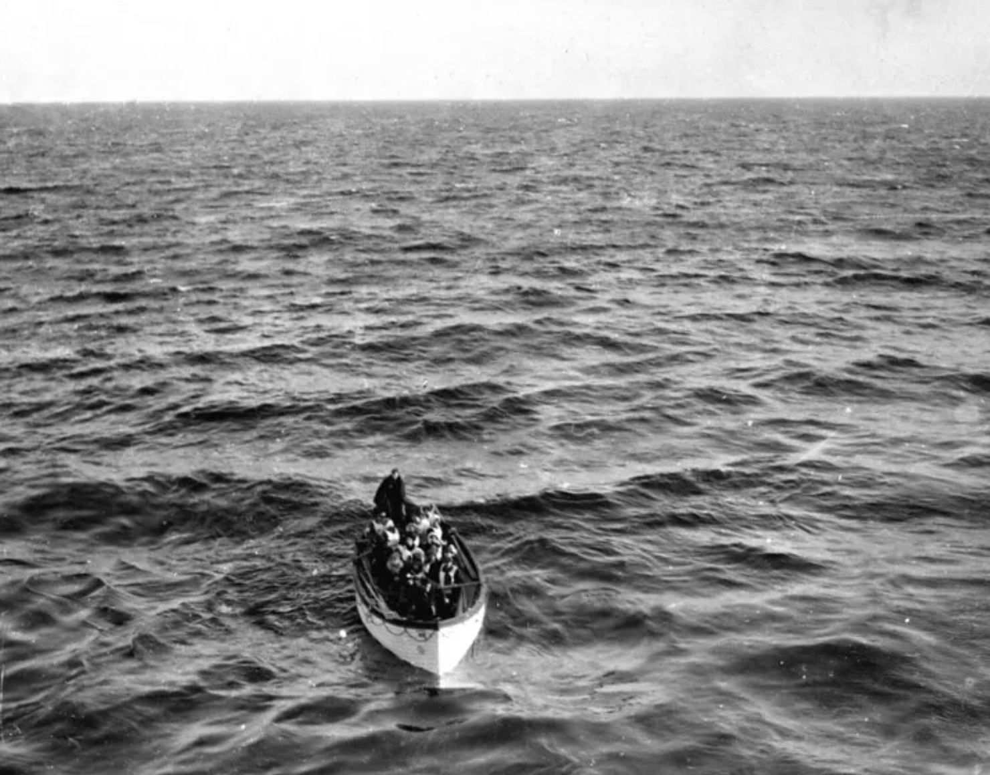
Digital Preservation of Social Media: Data Lifeboat
Goal: Digital preservation of social media - not just the images, but the conversation around them - for 100 years
LC co-hosted October 2024 strategy workshop with Flickr Foundation
Challenges and solutions:
Flickr is too big to archive in one place.
Principle of data lifeboat: crowdsource digital preservation
Many types of collections: family photos, professional images, historic archives
Curators self-select
How to archive others’ images that are copyrighted or have privacy concerns
Innovative consent and privacy approach
Ethical concerns about collections
Follow CARE principles: collective benefit, authority to control, responsibility, ethics. https://www.gida-global.org/care
Alpha in process: see datalifeboat.flickr.org

Slide 10
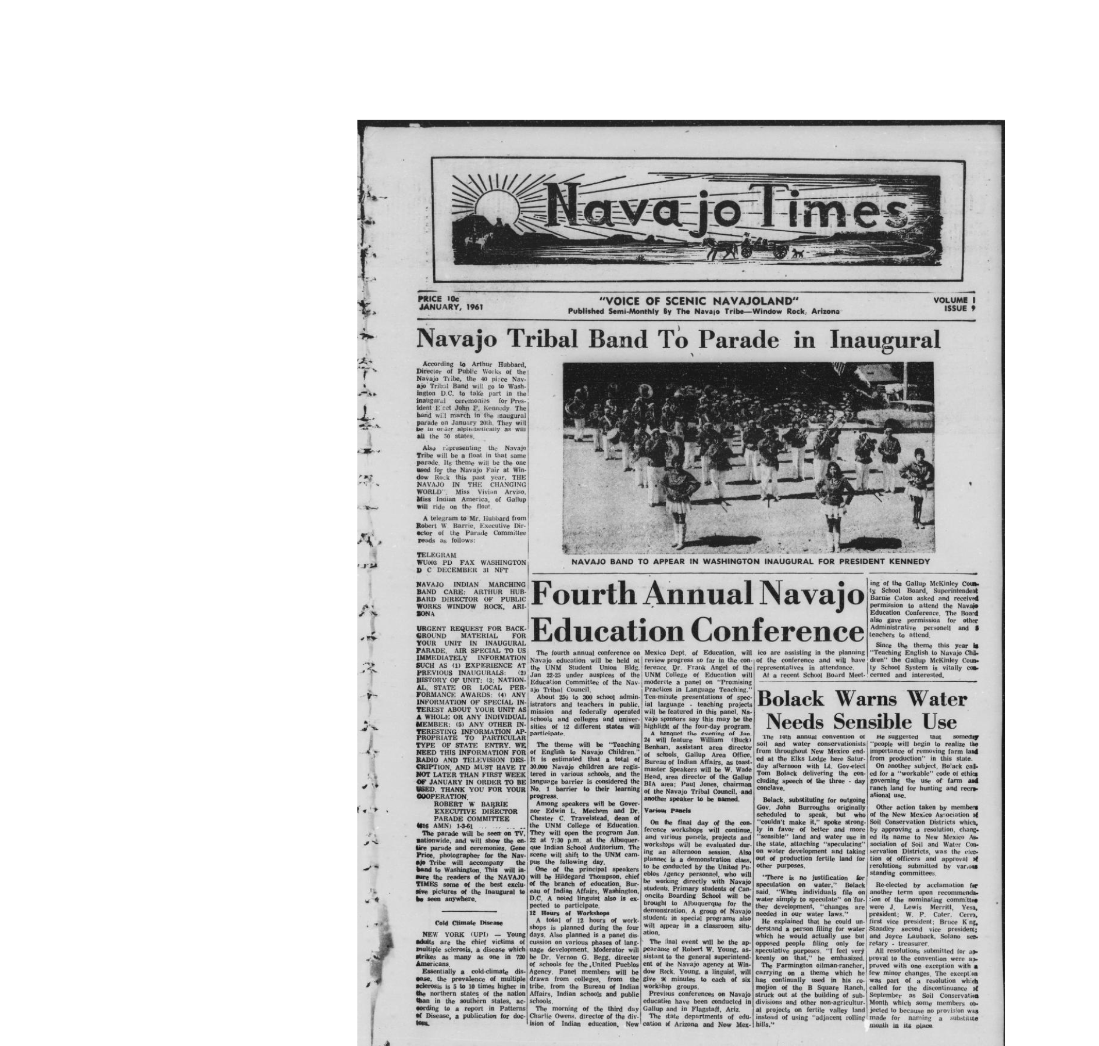
Community Engagement Matters:
Native American Collections
Comprehensive multi-year examination
of LC Native American Collections
Acquisitions and collections development
Provenance
Cataloguing
Descriptive resources
Cultural sensitivity
Community engagement
Access
Navajo Times. (Window Rock, Ariz.), 01 Jan. 1961. Chronicling America: Historic American Newspapers. Lib. of Congress. <https://chroniclingamerica.loc.gov/lccn/sn85047513/1961-01-01/ed-1/seq-1/

Slide 11
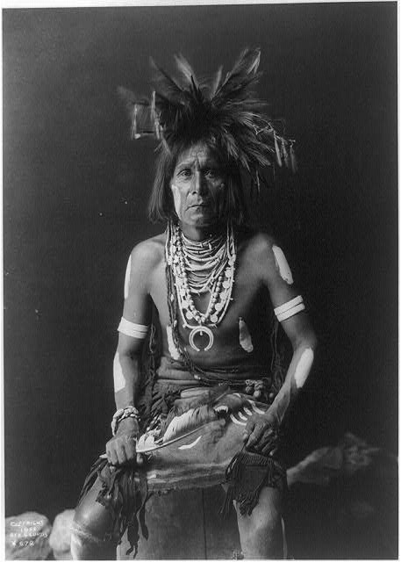
Collection Development Policy
Materials Relating to Indigenous Peoples of the United States, Canada, and Mexico Acquisition
Consultation with Indigenous communities on what is appropriate for preservation in the National Library is to be encouraged. In general, consultations with communities of origin when the Library acquires Indigenous material of potential cultural sensitivity is highly recommended. (As is creating a mechanism by which to compensate such advisors whenever appropriate.) Acquisition consultations or notification to tribal communities is particularly recommended when considering historical materials documenting Indigenous communities that may be of a culturally sensitive or sacred nature. Courtesy notification regarding new materials that have been added to the Library’s research and collections base is also highly recommended.
https://www.loc.gov/acq/devpol/materialsindigenouspeoples.pdf
Snake Priest, Edward Curtis, 1900 https://www.loc.gov/item/89710612/

Slide 12
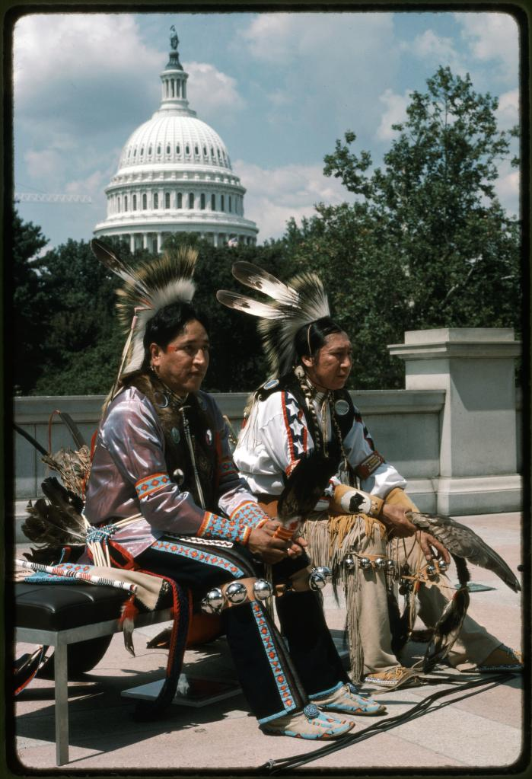
Access Policy
Culturally Sensitive Materials Relating to Indigenous Peoples of the United States, Canada, and Mexico:
“The Library is responsible for some collections and single items that may contain property and knowledge of Indigenous peoples of the United States, Canada, or Mexico that are not intended to be shared outside of a community of origin, should only be shared under certain circumstances, or may be identified as sacred in nature. The Library considers these culturally sensitive materials and establishes broad terms for their access and use within this policy. At times, the Library and communities of origin may establish shared stewardship agreements or memorandums of understanding establishing access and use rules beyond those in this policy. The Library acknowledges the need to consult with tribal partners in determining access and use restrictions, and prioritizes indigenous knowledge and communication from the communities documented in its collections, including communication on appropriate access and use of the related collections.”
https://www.loc.gov/acq/devpol/materialsindigenouspeoplesaccess.pdf
John Gibbs, Two Hethu'shka Dancers [Rudi Mitchell, Charles Lonewolf] at the Library of Congress Neptune Plaza. (1985)
https://www.loc.gov/item/omhbib000054/

Slide 13
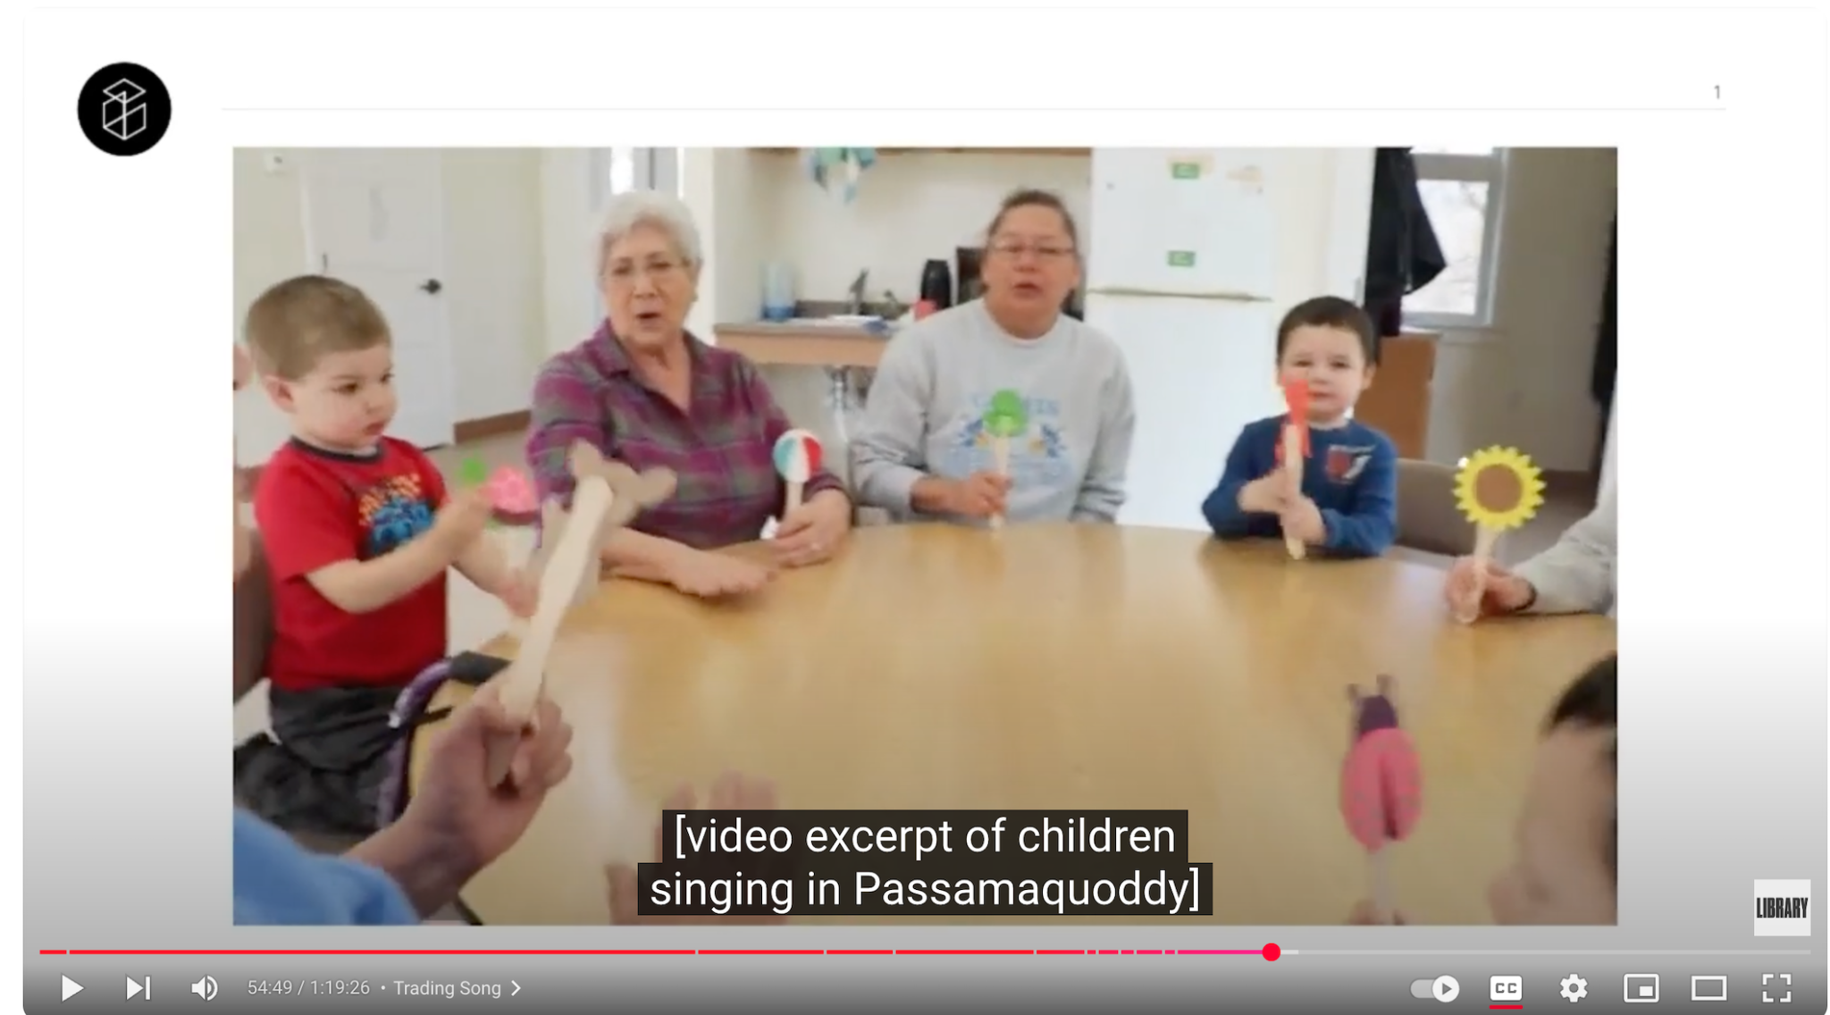
Ancestral Voices Passamaquoddy Project
The Passamaquoddy Tribe is made up of communities from Pleasant Point and Indian Township in Maine and St. Andrews, New Brunswick, in Canada.
36 cylinders of partial songs, legends, creation stories, and linguistic terms provided by Passamaquoddy community members, principally Peter Selmore and Newell Josephs, recorded by anthropologist Jesse Fewkes in 1890. Deposited in Harvard University's Peabody Museum, donated to the Library of Congress in the 1970s.
Harvard claims rights, negotiation required
LC contractual agreement and collaboration with Passamaquoddy Tribe, Local Contexts, and Mukurtu
Traditional Knowledge labels developed by Tribe. https://www.loc.gov/collections/ancestral-voices/ about-this-collection/rights-and-access/
Video workshop (2018) includes the first public performance of a Passamaquoddy song since 1890 https://www.youtube.com/watch?v=YIVHegzjJPo&t=3750s
[timecode 57:40-1.00:34 embedded]

Slide 14
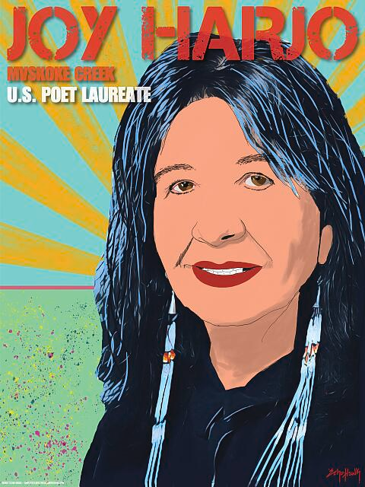
Cautions To Patrons
Disclaimer: “Through its Web sites, the Library is offering broad public access to a wide range of information, including historical materials that may contain offensive language or negative stereotypes. Such materials must be viewed in the context of the relevant time period.”
Privacy notice: “all users are responsible for complying with all privacy and publicity rights, rules, and applicable laws when accessing and utilizing the collections.”
Reader Registration form: “The Library asks that researchers approach the materials in our collections with respect for the culture and sensibilities of the people whose lives, ideas, and creativity are documented here.”
Amplifier - Echo-Hawk, Bunky - Miller, Shawn M. Joy Harjo, Mvskoke Creek, U.S. Poet Laureate(2020)

Slide 15
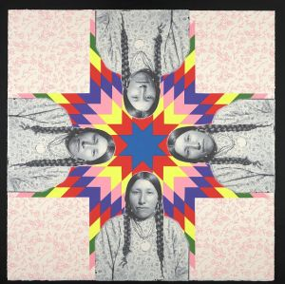
Highlighting Native Resources
The Library of Congress has long treasured and preserved Native American collections in a variety of formats. We acknowledge that some of these collections were acquired without the full consent of their communities of origin. Today, the Library is dedicated to building vibrant partnerships with Native American communities; providing respectful, consultative, and appropriate access to historic Native American materials; promoting innovative scholarship on Native American collections; collecting contemporary Native American works; and cultivating and celebrating distinguished achievements by Native American scholars and creators.
Wendy Red Star, Her Dreams Are True (Julia Bad Boy) (2021) https://www.loc.gov/item/2022635507/
https://guides.loc.gov/indigenous-peoples-resources

Slide 16
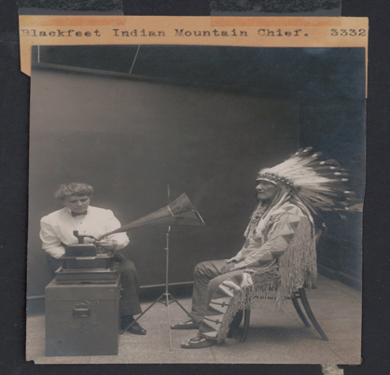
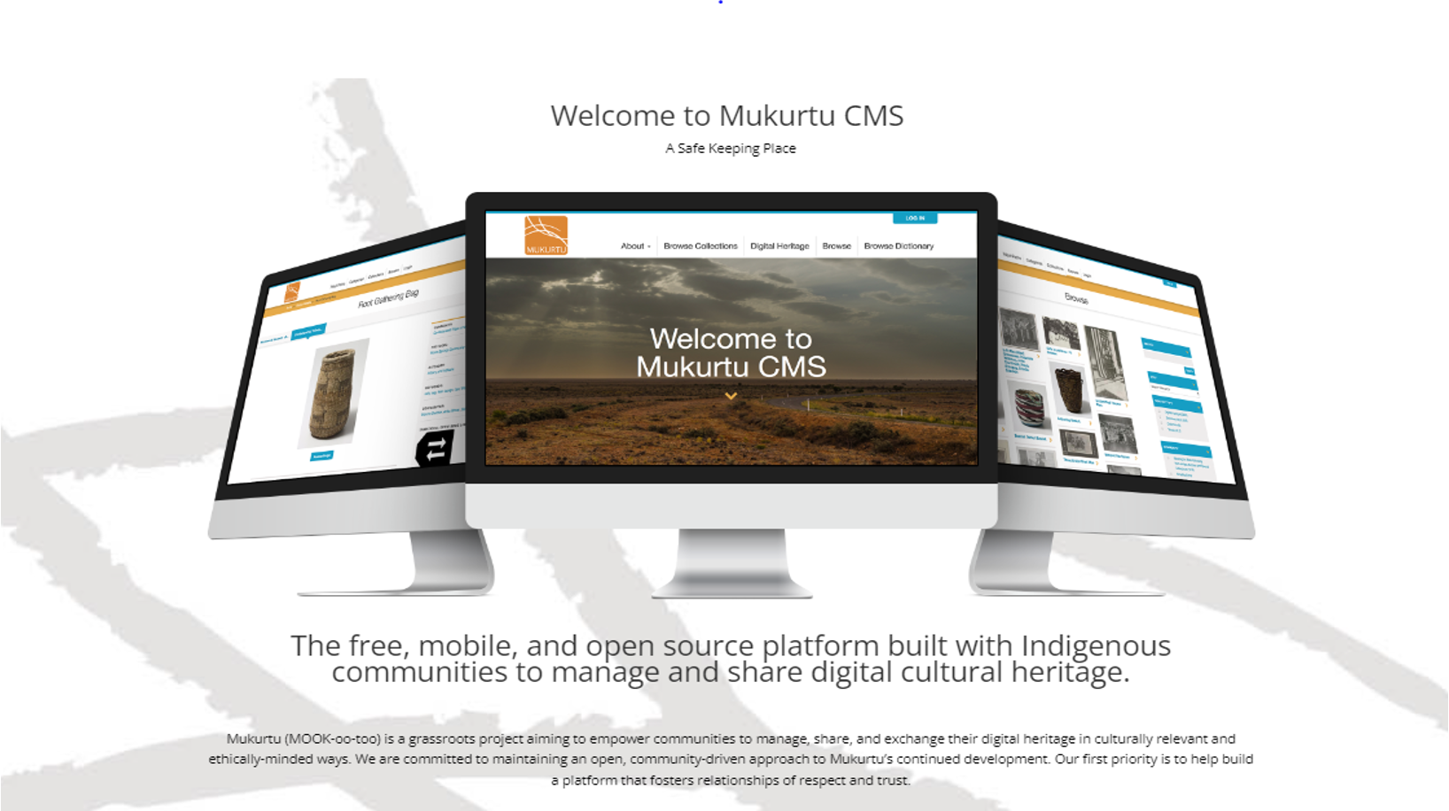
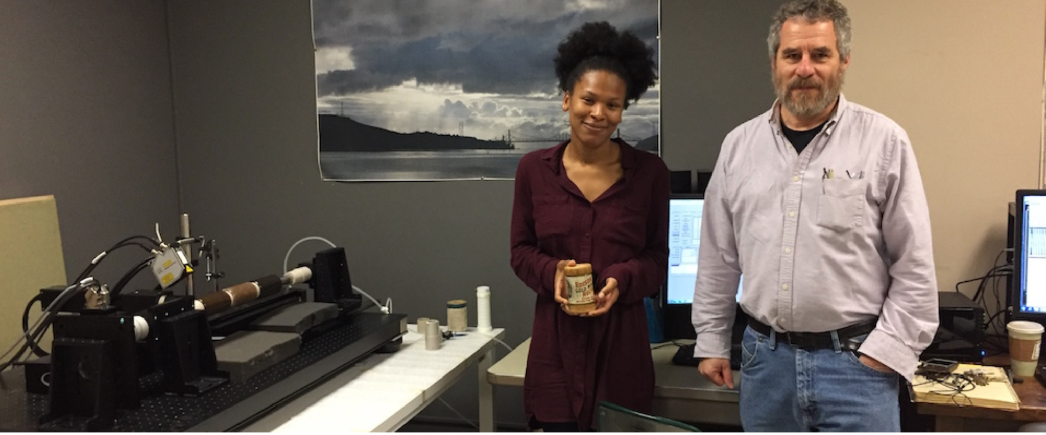
The Library is Part of a Federal Ecosystem
Advancing Access, Preservation, Innovation Matters
Projects: Mukurtu CMS
Lawrence Berkeley National Laboratory
(Left) Mukurtu Homepage at https://mukurtu.org/; (Upper Right) Piegan Indian, Mountain Chief, listening to recording with ethnologist Frances Densmore (1913); (Lower Right) IRENE, Olivia Dill, Carl Haber.

Slide 17
Institute of Museum and Library Services at a Glance
IMLS is “the Connective Tissue of America’s Library and Cultural Institutions.” IMLS Matters!
Primary source of Federal support for America’s over 124,000 libraries and archives and 33,000 museums
Mission: Primary responsibility for the development and implementation of policy to ensure the availability of museum, library, and information services adequate to meet the essential information, education, research, economic, cultural, and civic needs of the people of the United States
(20 U.S.C. Section 9103)
Advise the President, Congress, and other Federal agencies
Engage Federal, State, and local government agencies and private entities in assessing needs and coordinating plans, policies, and activities (Tribal Libraries, State Library Administrative Agencies)
Carry out programs of research and development, data collection, and financial assistance
Ensure that museum, library, and information services are integrated into the information and education infrastructures of the United States
Source: https://libguides.ala.org/c.php?g=751692&p=9132142

Slide 18
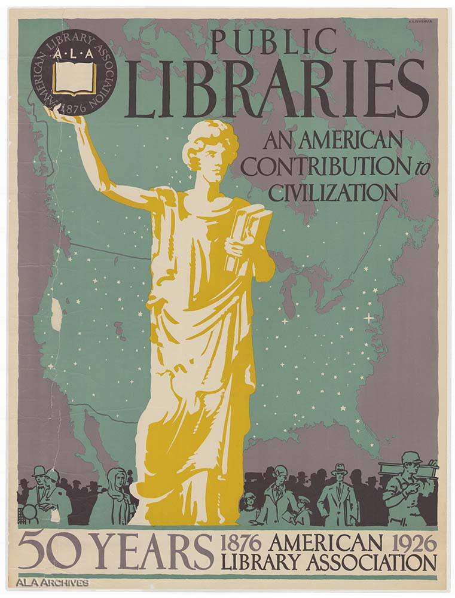
Number and Types of Libraries in the United States
Source: https://libguides.ala.org/c.php?g=751692&p=9132142

Slide 19
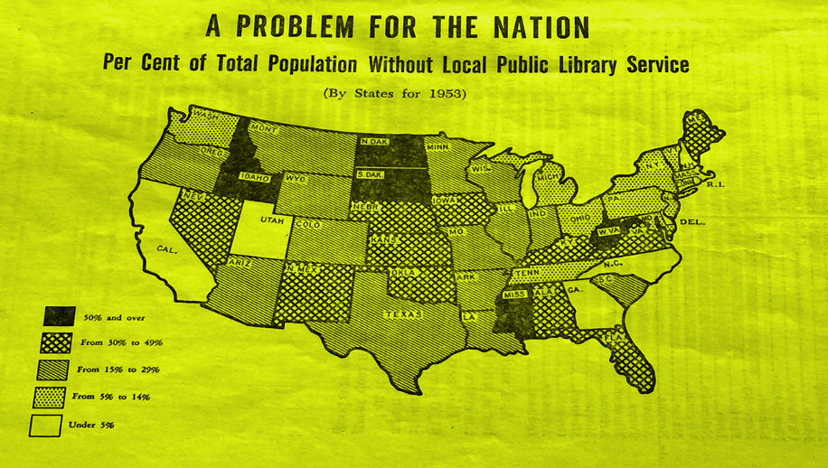
The Availability of Library Services Throughout the Nation Matters
Library Services (and Technology) Act dates back to 1956 (in development and piloted since1938)
Predecessor agencies include the National Commission on Libraries and Information Services, Informed Section 108)
Museum Services Act dates back to 1976 (Bicentennial)
Fostered the creation of the Heritage National Emergency Task Force (HENTF) and tools for disaster planning and response
https://culturalrescue.si.edu/who-we-are/hentf
Federal Aid for Library Service in Rural Areas: Hearing before the Subcommittee on Education and Labor of the House of Representatives on Bills to Promote the Further Development of Public Library Services in Rural Areas 84th Cong. 27 (1955).

Slide 20
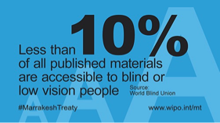
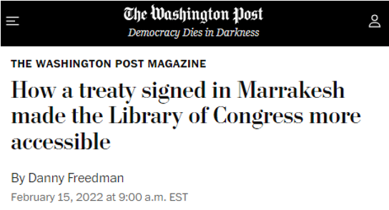
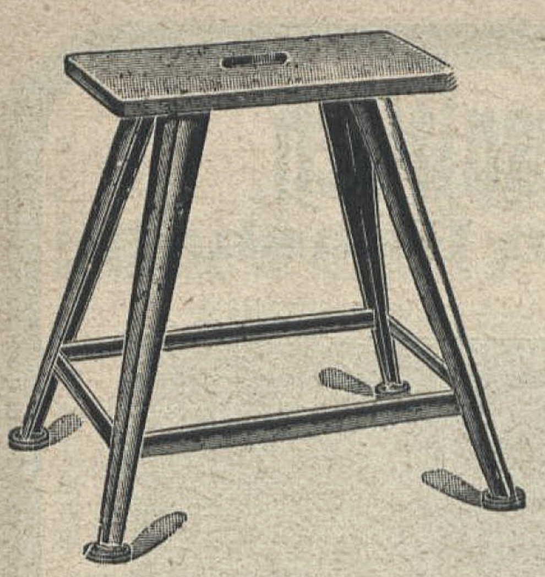
Accessibility Matters! The Marrakesh Treaty
The WIPO-administered Marrakesh Treaty makes the production and international transfer of specially-adapted books for people with blindness or visual impairments easier. It does this by establishing a set of limitations and exceptions to traditional copyright law.
Updated 17 U.S.C. Section 121 and added a new121a (Chafee Amendment)
“Eligible Person” – has a “print disability”
”Accessible Formats” now defined more broadly
Expanded the types of works allowed to be copied from nondramatic literary works to all literary works, plus musical works fixed in the form of text or notation.
Strategic Synergy: How It All Comes Together:
NLS curates and distributes accessible content
IMLS funds the infrastructure
State libraries and supervisory authorities ensure local implementation
USPS delivers the materials, bridging the final mile

Slide 21
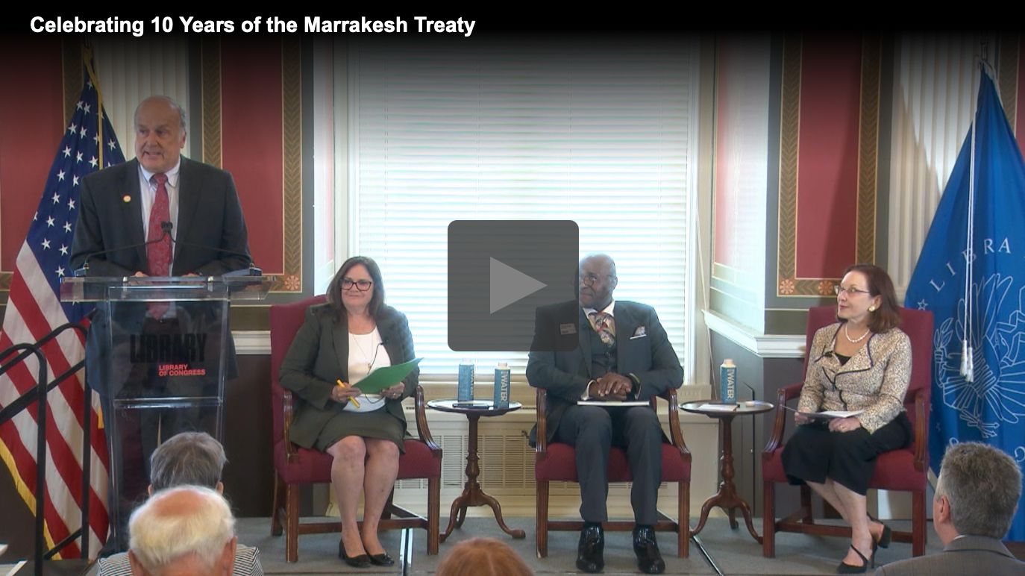
Accessibility Matters! The Marrakesh Treaty
Since 2020, NLS has added 9,567 Marrakesh Books to its collection, which have been downloaded 180,325 times. The materials are in 28 different languages.
NLS has uploaded 206,106 books to ABC’s Global Book Service, which have been downloaded in 36 countries.
Music Scores: Leonard Cohen’s “Hallelujah,” as well as Adele and Bach
Most popular? Harry Potter in French and German, among others
https://www.copyright.gov/events/marrakesh-treaty-tenth-anniversary/

Slide 22
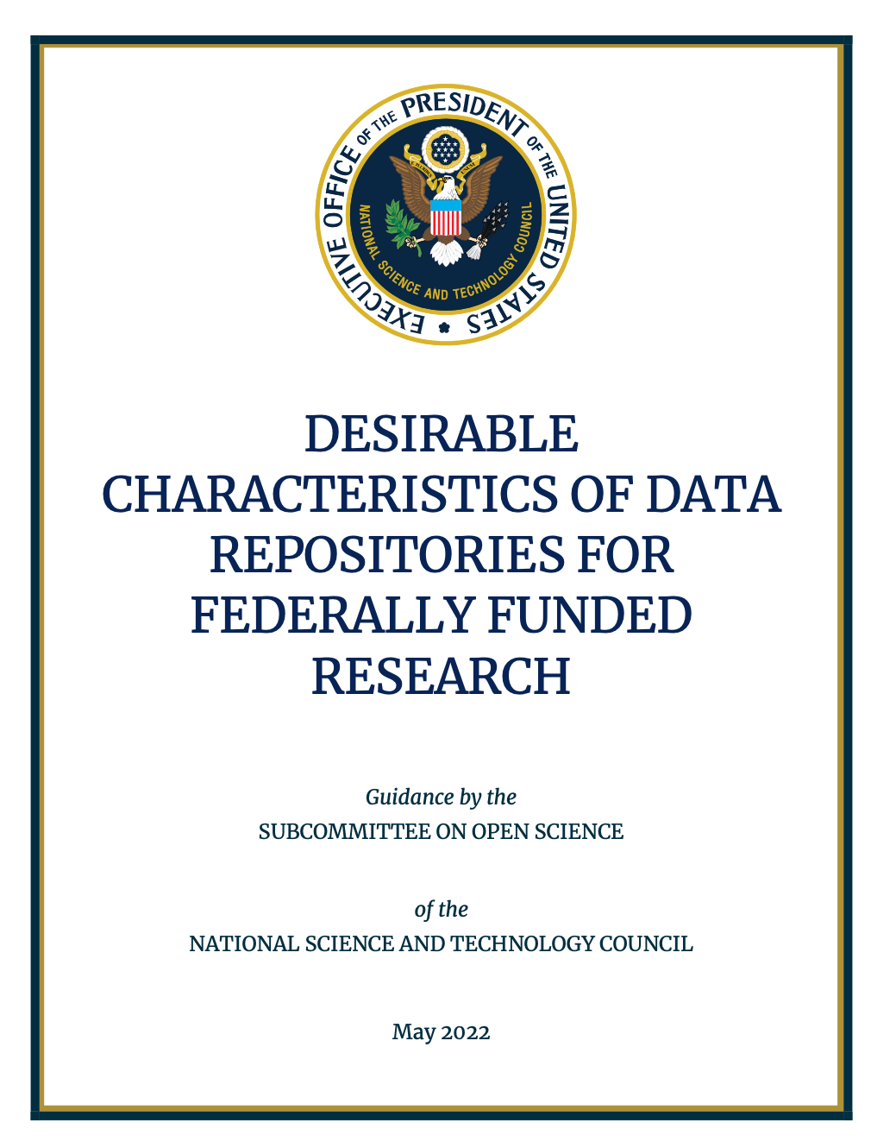
Federal Libraries and Information Policies Matter!
The free flow of information between the Government and the public is essential to a democratic society.
Making Federal information discoverable, accessible, and usable can fuel entrepreneurship, innovation, and scientific discovery that improves the lives of Americans, and contributes significantly to national stability and prosperity, and fosters public participation in Government.
Promoting openness and interoperability, subject to applicable legal and policy requirements, increases operational efficiencies, reduces costs, improves services, supports mission needs, and increases public access to valuable Federal information.
OMB Circular A-130

Slide 23
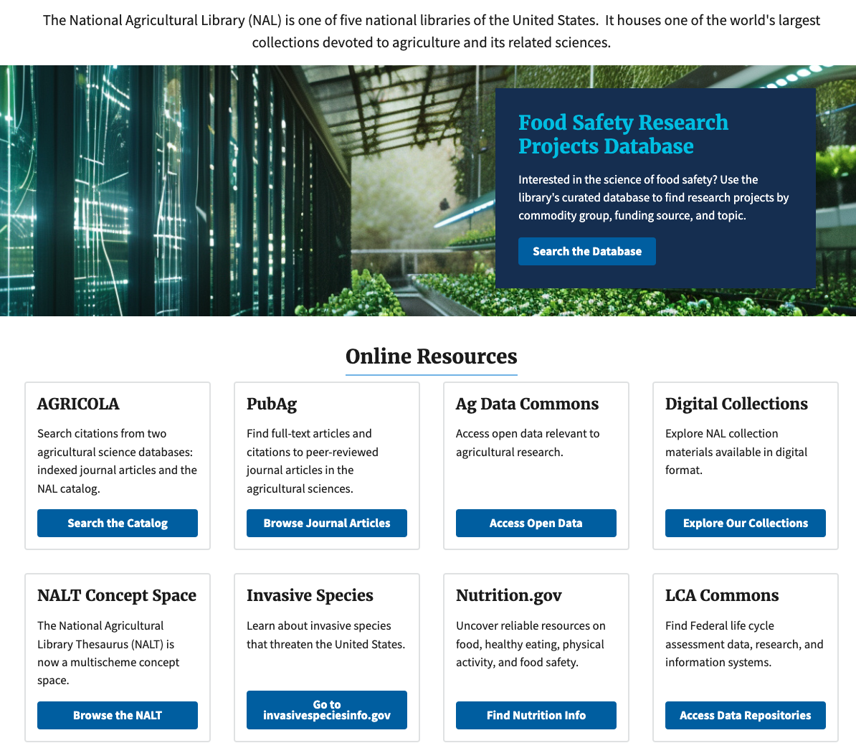
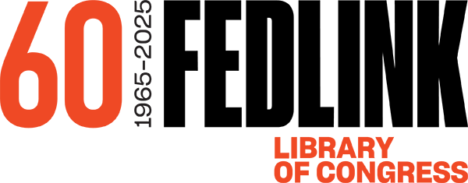
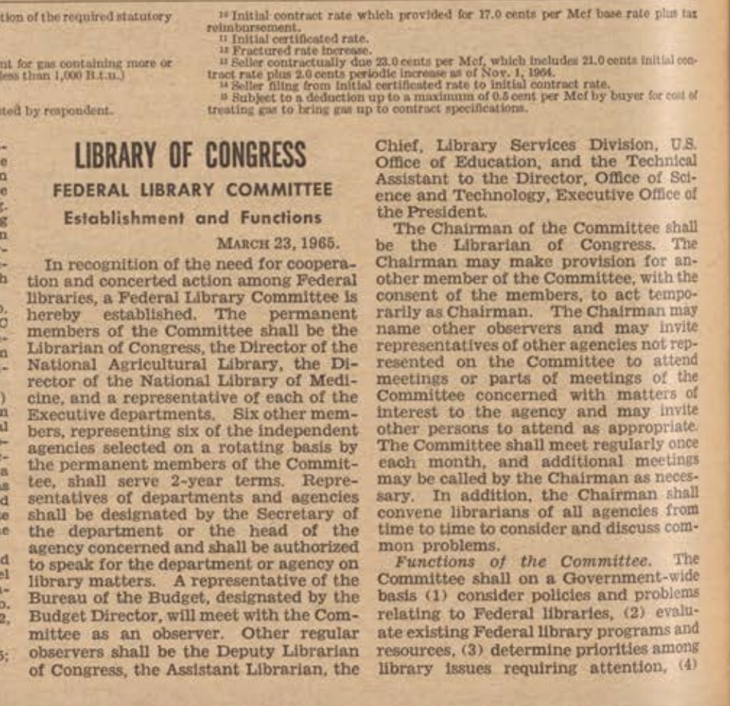
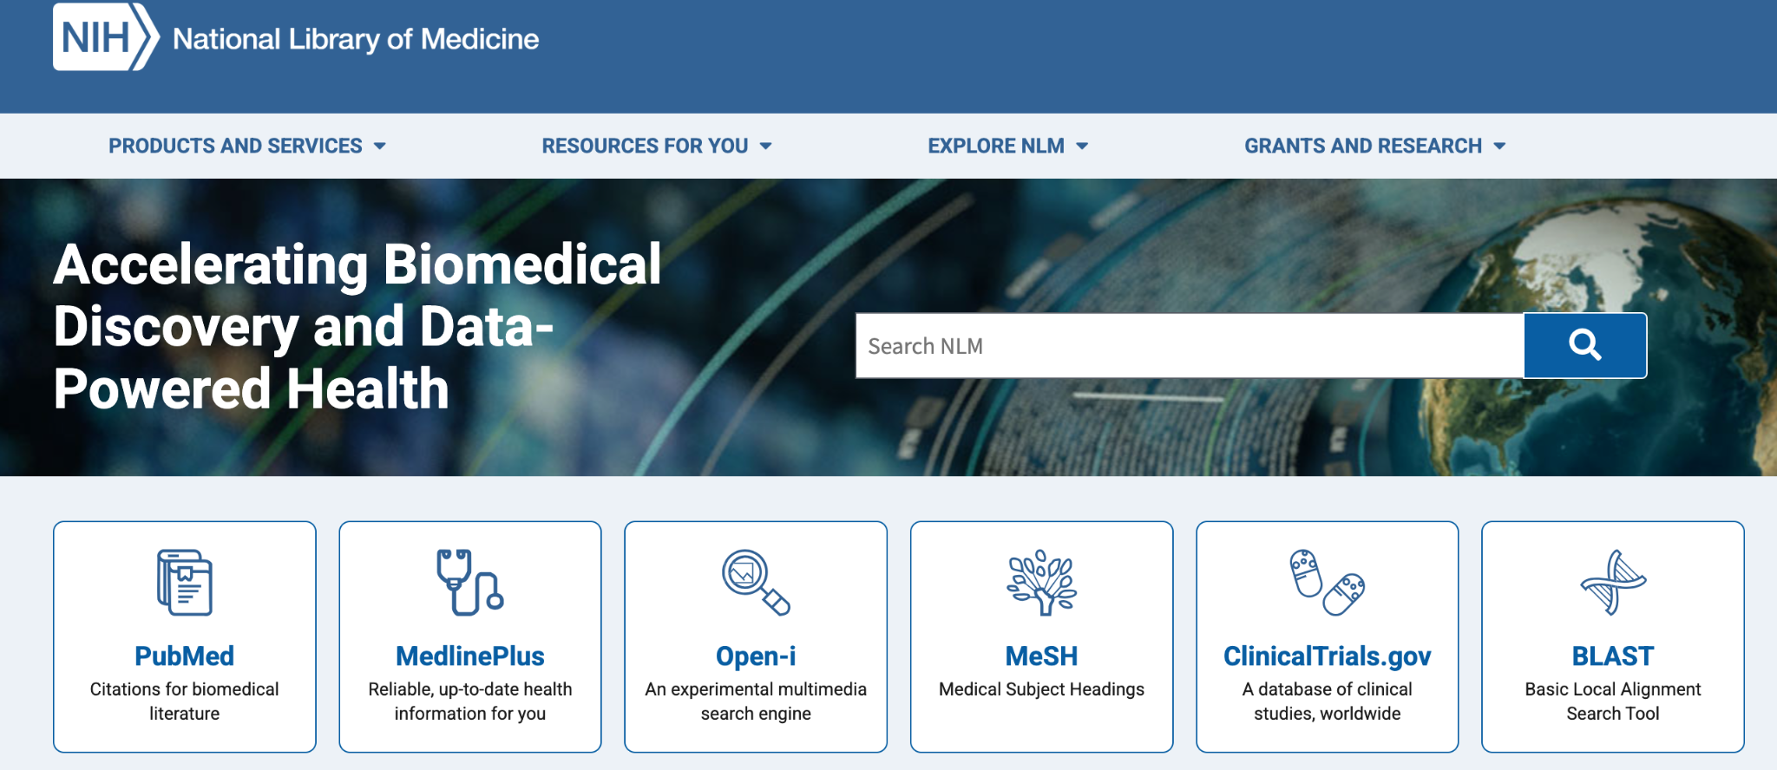
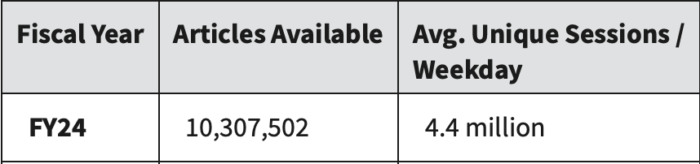
Federal Libraries
Library of Congress
National Archives
National Library of Medicine
National Agricultural Library
National Library of Education
National Transportation Library
Federal Libraries and Information Policies Matter!

Slide 24
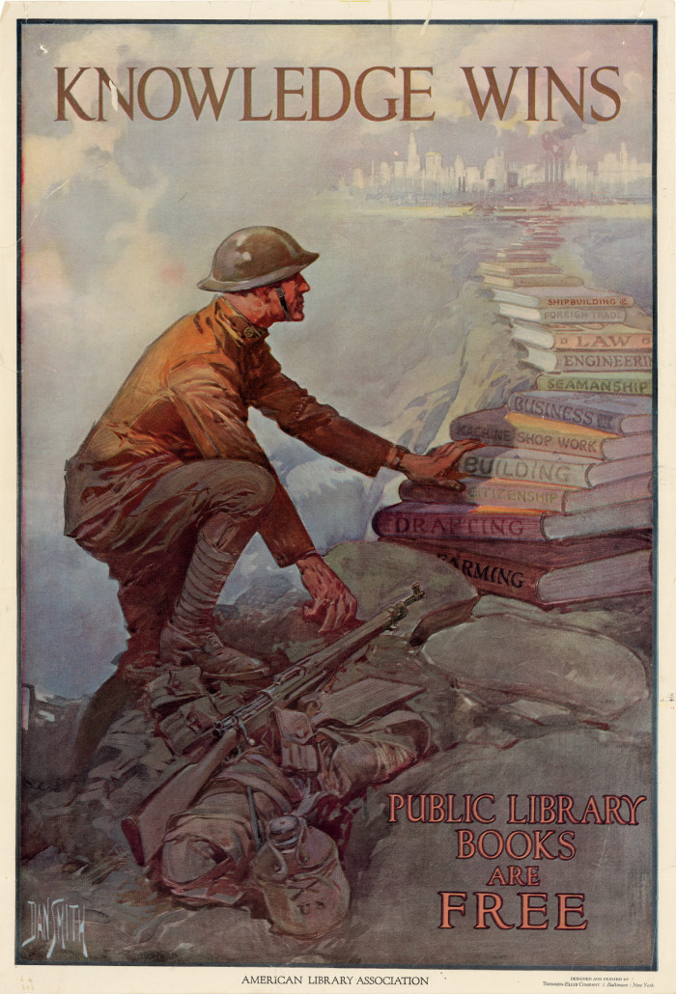
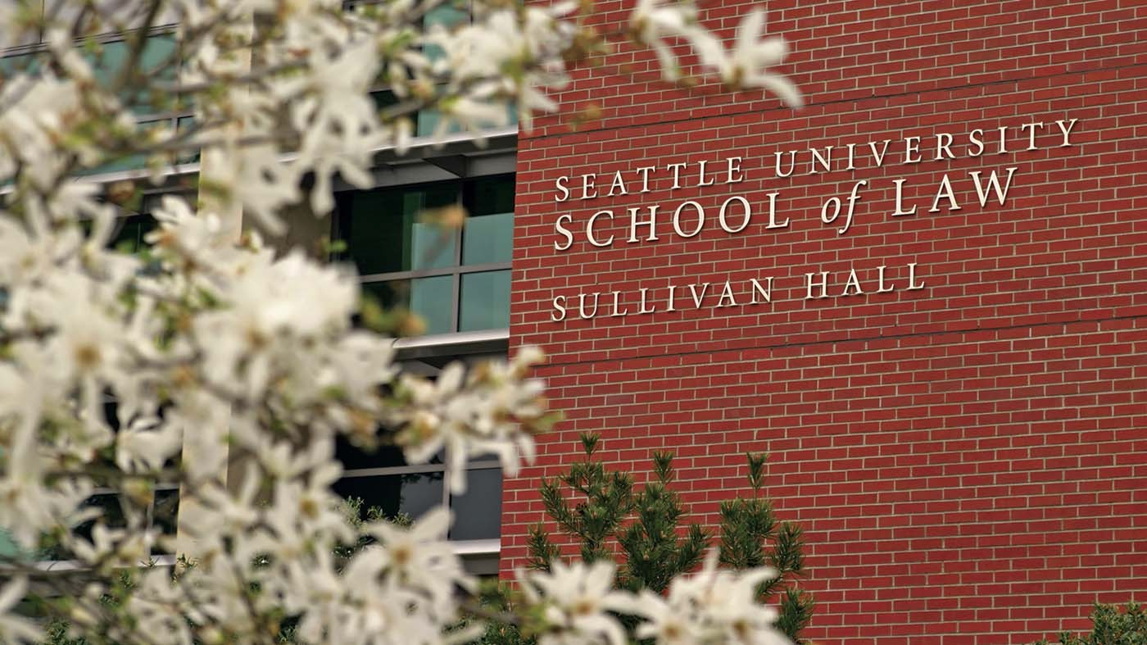
You Matter!
Thank you!

