Slide 1
ConnectSU Guide
School of Law Student Organizations

Slide 2
Overview
Navigating ConnectSU (Slide #3)
Your Organization’s Homepage (Slide #12)
Common Tools (Slide #14)
Events (Slide #16)
Roster/Members (Slide #18)
News Articles (Slide #23)
Forms (Slide #25)
Contact Information (Slide #27)

Slide 3
1. Navigating ConnectSU
Getting started:
Let’s login
https://seattleu.campuslabs.com/engage/

Slide 4
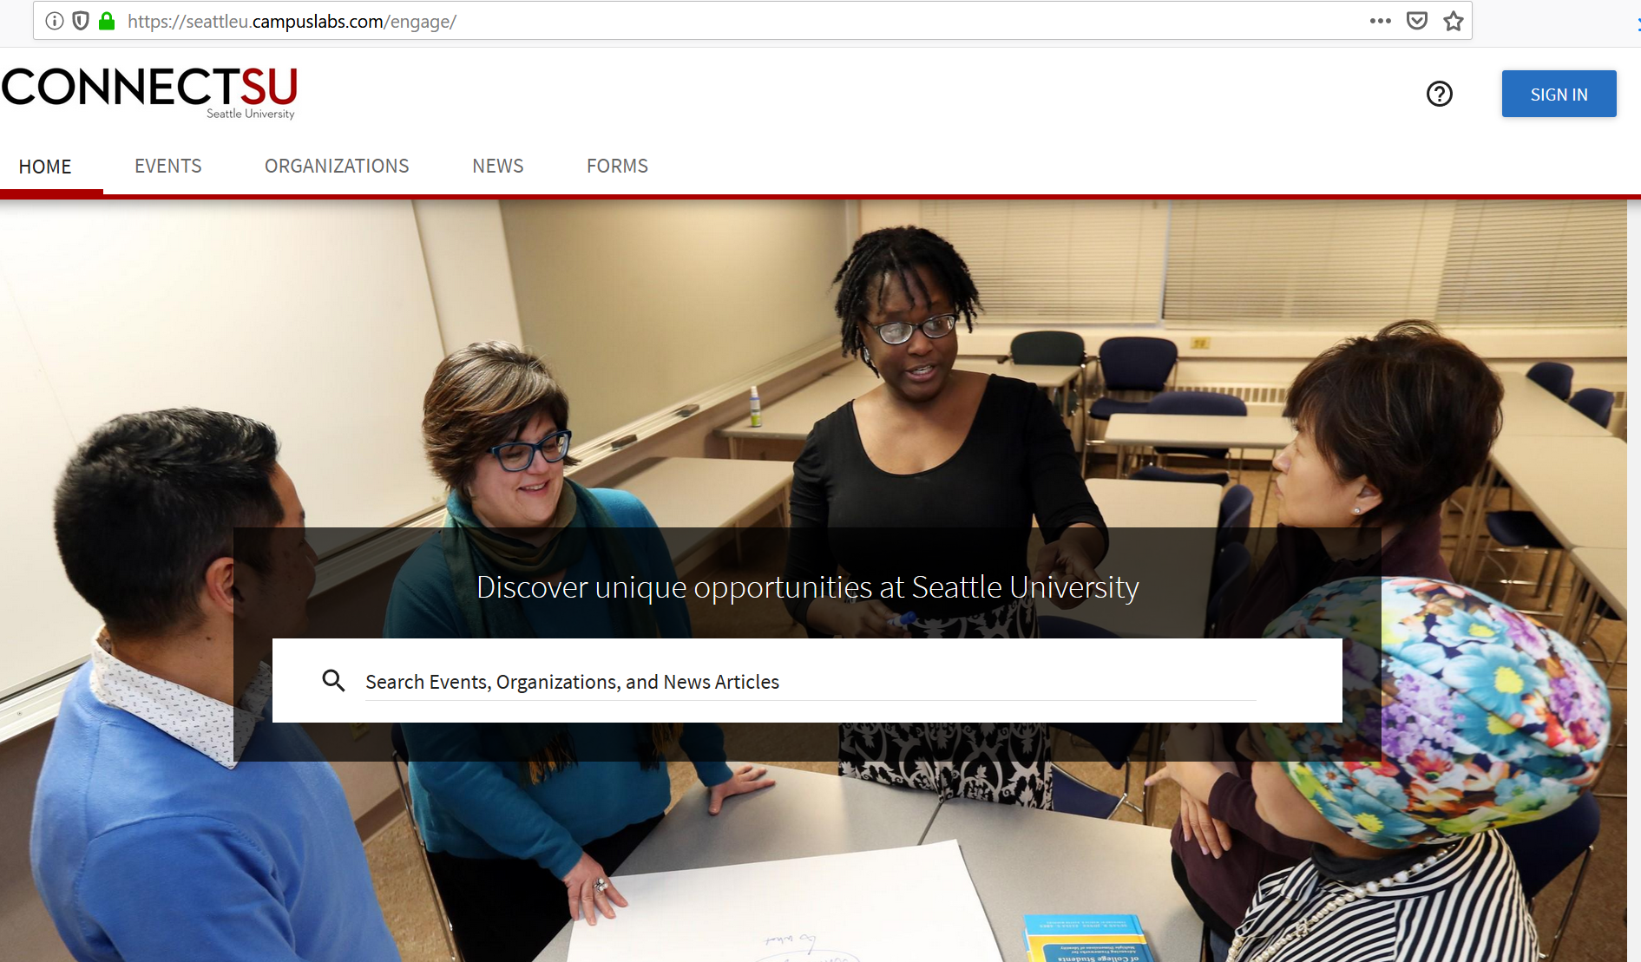
Sign in with your campus ID
This is the same ID you use to sign into your Seattle University email

Slide 5
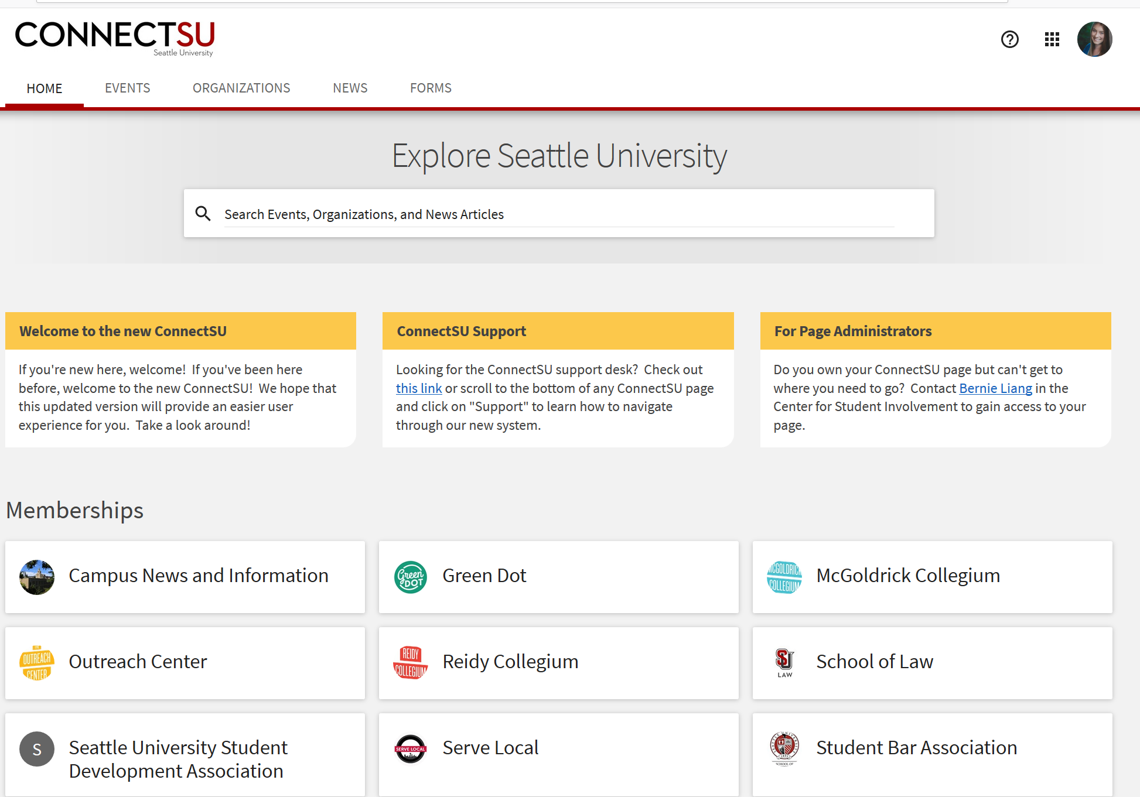
ConnectSU
Homepage
Use the search bar to find ways to get involved with Main Campus!
These will be the “Memberships” you’ve joined

Slide 6
School of Law Main Page
Upcoming Events
Organizations
News Feed
Forms & Files

Slide 7
Events
Make sure “School of Law” is selected under Branches
Keep up to date with events and activities happening on campus!

Slide 8
Events cont.
The events can be added to your personal Google or Outlook calendar

Slide 9
Organizations
Make sure “School of Law” is selected under Branches
Great way to find law organizations to join & learn more about!

Slide 10
News Feed
Keep up to date with Student Life, School of Law, and other campus news

Slide 11
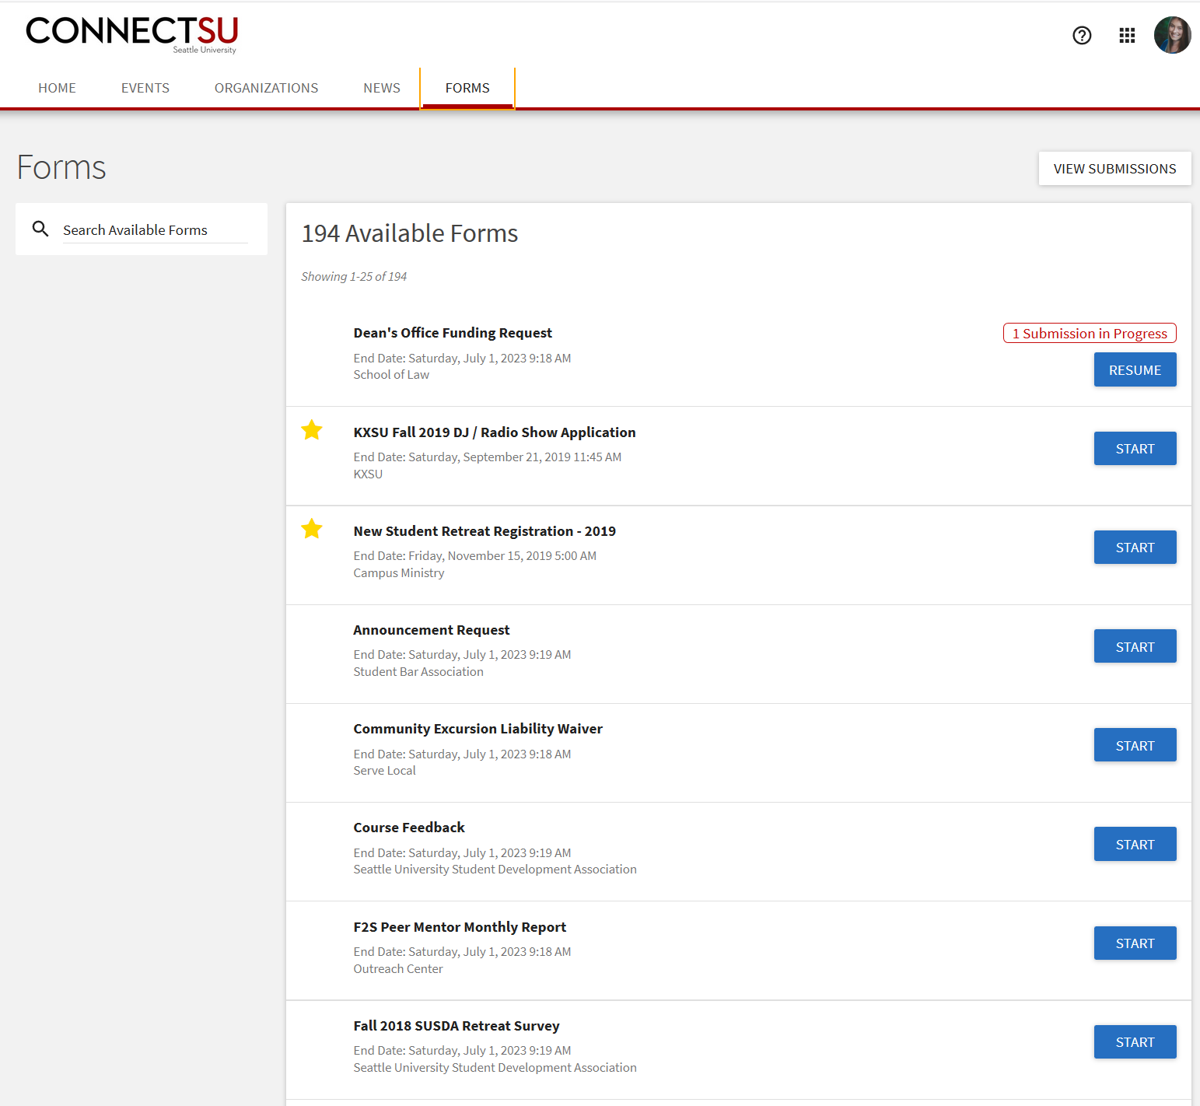
Forms
Here you can find helpful forms for your Organization
These documents are useful for:
Finding information about Fundraising
Referencing the Student Handbook
Requesting Funds from the Dean’s Office

Slide 12
2. Your Organization’s Homepage
Back on your Home Page
Click on the Switch Applications icon, located at the top of the page. Then click “Manage.”

Slide 13
This will bring you to your Action Center, where you can manage your org’s page.
Select your organization’s page

Slide 14
3. Common Tools
Once on your Org’s home page, click on the drop down menu to select your choice of action

Slide 15
Action Center
Here you can utilize various tools to:
Add members
Create events
Post News
Fill out/design forms
And more

Slide 16
Creating an Event
Click on “Events” under Organization Tools, then you’ll arrive to this page.
An ”Event” includes
Regular organization meetings
One-time events or socials
Announcements of Tabling
And more
Manage Events:
This overview section helps you keep track of events you’ve created and check on the status of your events.
Create an event

Slide 17
1st: Click on create an event
Details to Include:
Event Name
Category
Description
Time/Desired
Location
Event Image
RSVP Information
2nd: This will bring you to a form to fill out for your event.

Slide 18
Managing Members
In your Action Center, click on “Roster”
(see slide 15)
Reasons to utilize Roster include
Invites specific people/groups to events
Identify committees or task forces
Easily message members of a certain group
Grant group specific permissions to access files or forms

Slide 19
Roster Main Page
Manage Positions
Invite People
Primary Contact Person
Member Position Status

Slide 20
Manage Member Positions
Click “Position” to add a new position title for a person that is unique to your organization. You can grant no, all, or limited access.

Slide 21
Invite People
Click on “Invite People” in the top corner of your Roster main page
(see slide 18)
You will invite people to join your organization via their seattleu email

Slide 22
Member Position Status
Attend to pending membership requests and manage current members

Slide 23
News
In your Action Center, select the “News” icon
(see slide 15)
Keep your members up to date with News!
Ways to best utilize News include
Regular Newsletters
Announcements or important memos
Follow up with a recap of an event
Create a news article/update

Slide 24
Creating a News Article
When completed, create/publish your article
Upload and caption an image
Details to Include:
Title
Brief Summary of Article
Insert content
Add a hyperlink
Manage who has access to view this news post
Notify organization’s members of the news article

Slide 25
Utilizing Forms
Create a new form
In your Action Center, click on “Forms”
(see slide 15)
Fill out an already active form

Slide 26
Create a New Form
Select the style of questions for your form
Save and continue to add questions

Slide 27
4. Contact Info
If you have any questions about ConnectSU, feel free to contact Tony Vo
vot1@seattleu.edu
(206) 398-4206
Sullivan Hall, 2nd Floor, Room 209
Thank you for your time!

